Slide 1


Headcount and Budget Summary -
Starting
Terms
TX Out
Hires
TX In
LOA Start
LOA End
Ending
DETAILS
DETAILS

Slide 2
Headcount and Budget Summary -
Starting
Terms
TX Out
Hires
TX In
LOA Start
LOA End
Ending

Slide 3
Headcount Detail -
Starting HC
Ending HC
Current Roster

Slide 4
Headcount Detail -
Starting HC
Ending HC

Slide 5
Budget Detail -

Slide 6
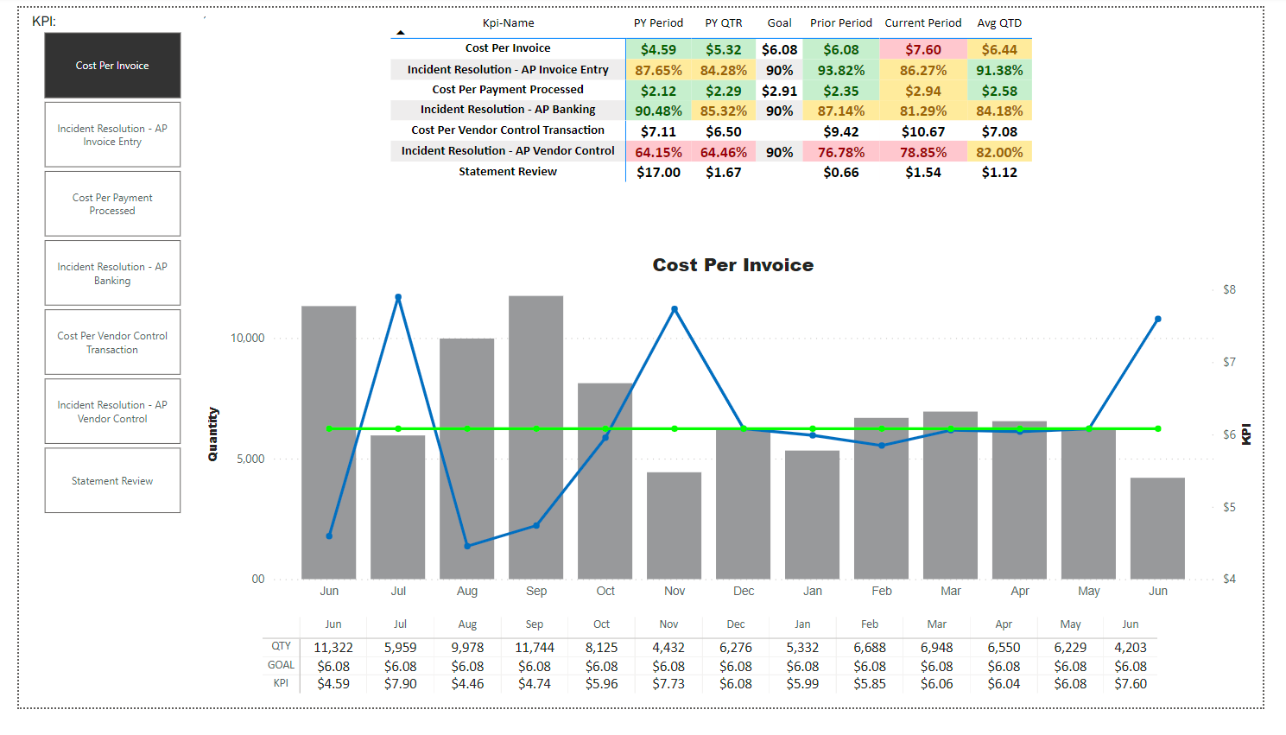
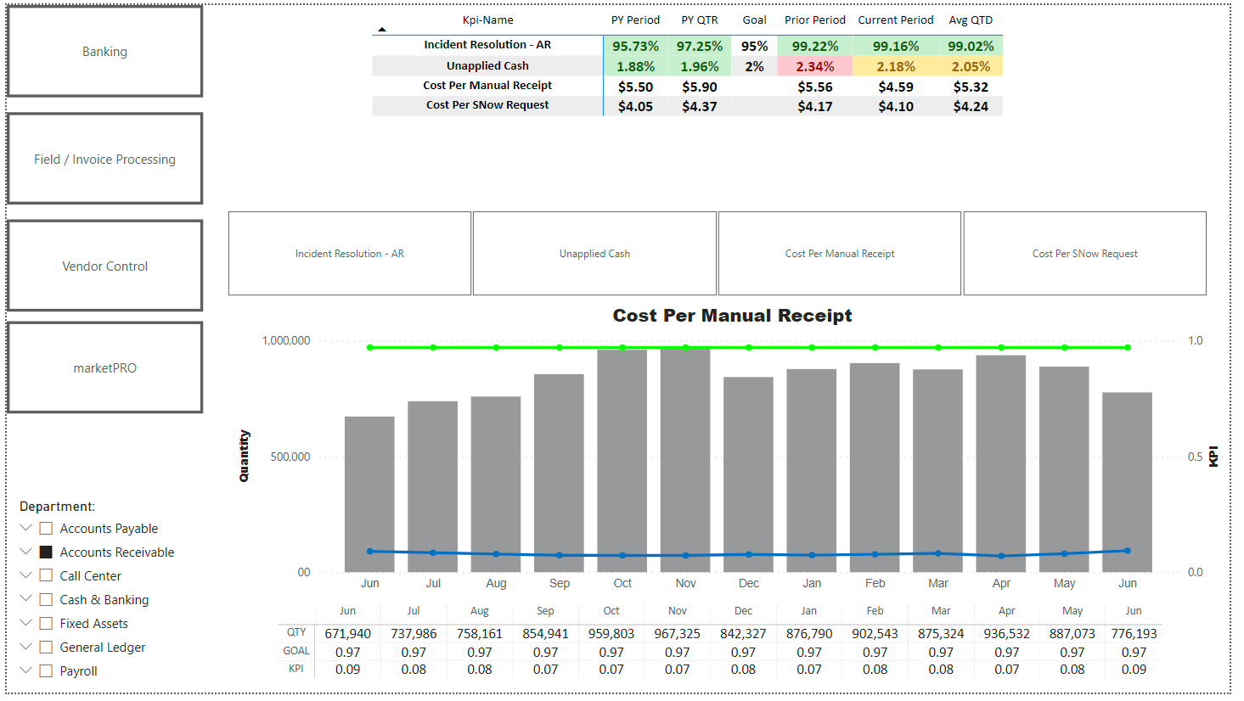
Department KPIs -

Slide 9
Headcount Detail -
Starting Headcount
Terminations
New Hires
Began Leave of Absence
Ending Headcount
Transfers Out
Transfers In
Ended Leave of Absence

